Slide 1



Marketing Presentation
Presented By:
Presented To:
DR/ Amira Sharaf
Digital Egypt Pioneer

Slide 2
Agenda
3 | Campaign Goals
4 | Branding
5 | Schedule and Deadlines
6 | Budget
7 | Marketing Team
8 | Marketing Channels
9 | Marketing Mix
10 | KPIs

Slide 3

Clinic Overview
The clinic is led by Dr. Mohamed Yehia Sharaf, a highly experienced professor and lecturer in Egypt and abroad.
The clinic provides high-quality dental care with a strong reputation in the local area.
The clinic offers a wide range of dental services, including: (Cosmetic dentistry Laser treatments Fillings, extraction, and cleaning Pediatric dental care Dental prosthetics for elderly patients).
The clinic is known for its professional standards, continuous sterilization, and special care for children and elderly patients.

Slide 4

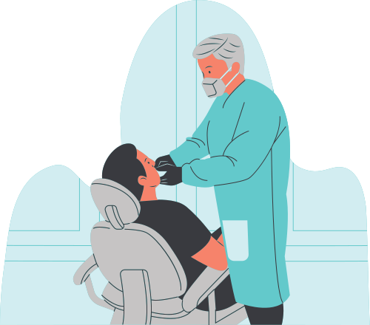
Campaign Objective
Goals:
Build strong brand awareness on Facebook and Instagram.
Increase the number of new patients visiting the clinic.
Promote the clinic’s unique strengths (doctor’s expertise, sterilization, and
child-friendly care).
Generate engagement and trust through consistent content and offers.
Expansion and new openings

Slide 5
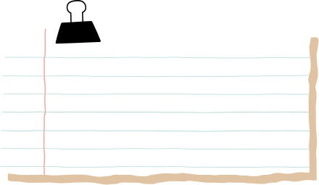

SWOT Analysis
Strength
Weakness
Professional reputation built on years of experience
Strong academic expertise.
State-of-the-art equipment.
Digital marketing just starting.
Limited online visibility compared to competitors.
Relying on the doctor's personality without highlighting the assisting medical team.
Opportiunities
Threads
Economic conditions affecting patients’ budgets.
High competition in the area.
The limited number of strong centers with the same scientific level in the region necessitates
expansion and the opening of more centers.
Start Digital marketing.

Slide 6
STP
Segmentation | Targeting | Positioning
Families | Surroundin erea | more comfortable with high dental care
Seniors | Seniors need dentures
need medicine | Class A and B+ | Premium service at competitive price
Cosmetic | Seeking cosmetic | Comine academic knwledge with practical experince

Slide 7

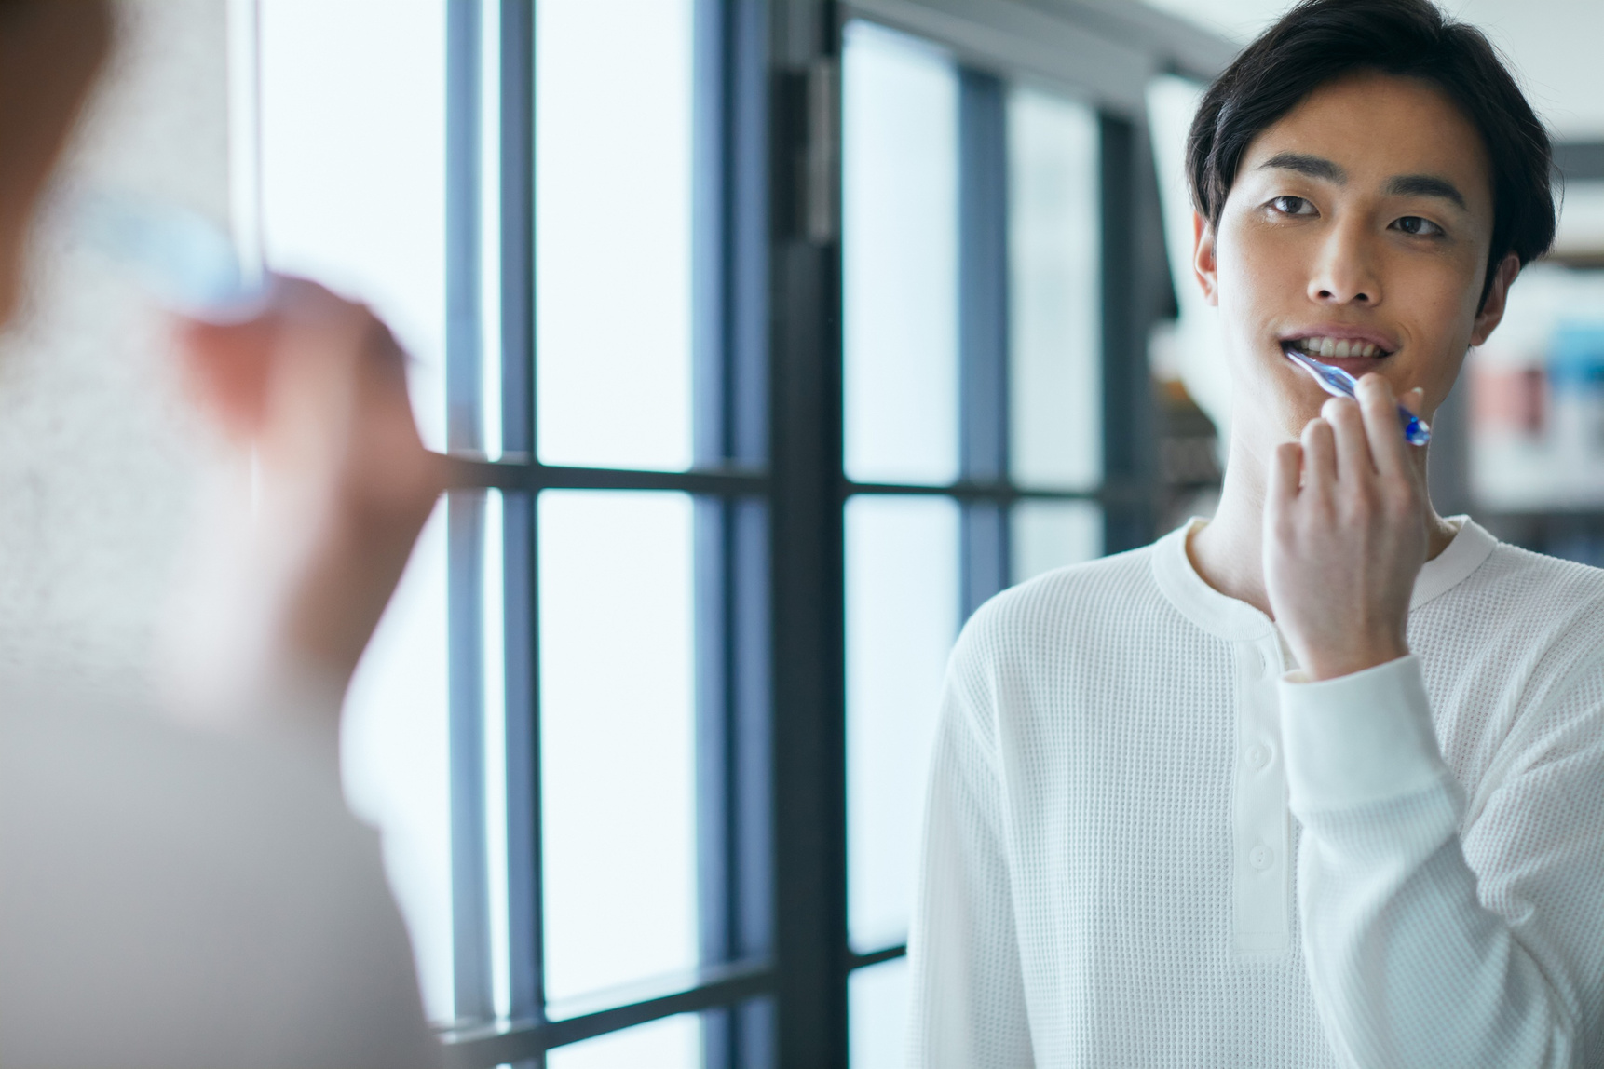
Buyer persona
Patient seeking for treatment :
Name : Marawan
Age: 25 year
Identifiers : need quick , painless treatment from an excellent doctor.
Fears: Repeated visits , continous pain

Slide 8
Buyer persona
Patient seeking for Cosmetic :
Name : Laila
Age: 30 year
Identifiers : High interest in appearance ,
Fears: Paying a lot of money for service dosent meet expectation , or change the doctor in the mid of treatment.

Slide 9
Buyer persona
Seniors :
Name : Hany
Age: 65 year
Description : Struggling to eat due to loss of teeth
Fears: Discomfort from dental structure
Marketing message :

Slide 10
Buyer persona
Family :
Name : Ali
Age: 10 year
Description : Fathers and mothers who care with their children .
Fears: Hygiene , sterilization standards.
Marketing message :

Slide 11
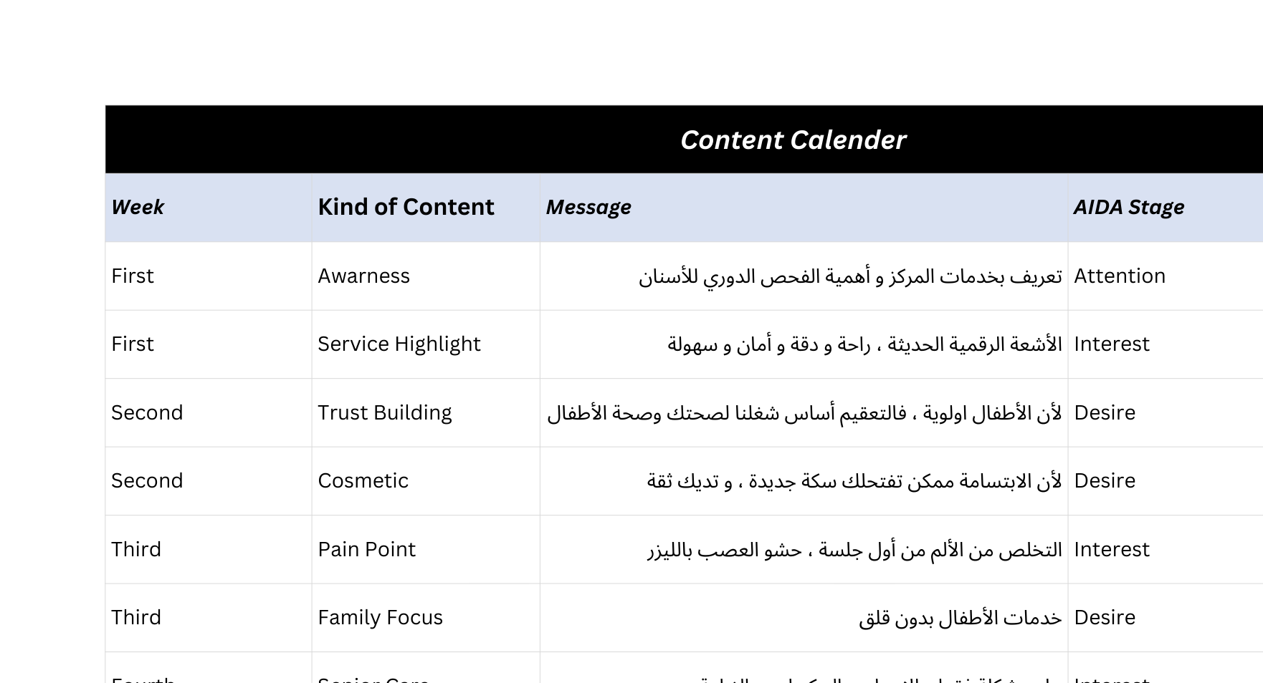
Schedule and Deadlines
Lay out the timeline for the marketing activities and initiatives that will make the campaign succcesful.
October
November
December
January
Conduct market research.
Finalize public relations and media plan.
Hold sales promotions.
Write another activity, deadline or milestone here.

Slide 12
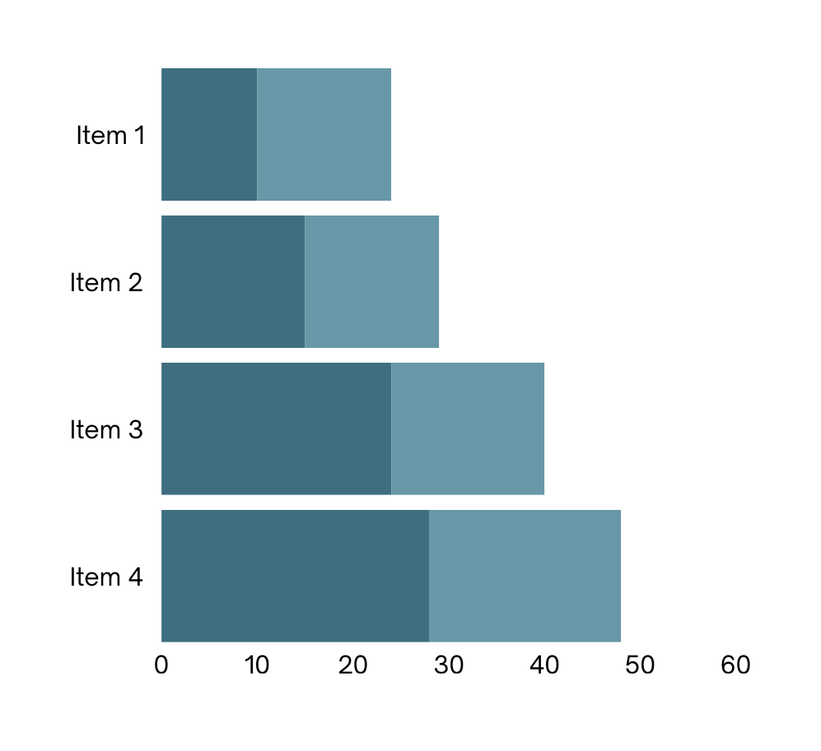
Budget
Costs and Expenses:
Social media Ads 50 %.
Content Creation 30 %.
In - clinic Branding 20 %.
Total Budget 2000 EGP.

Slide 13



Marketing Channels
Marketing Channel 1
Marketing Channel 2
Marketing Channel 3
Facebook
Instgram
Google account

Slide 14





Marketing Team
Team Member
Team Member
Team Member
Team Member
Team Member
Add role here
Add role here
Add role here
Add role here
Add role here

Slide 15
Marketing Mix
Optimize this marketing plan by identifying the following details of the campaign.
Product/Service Marketed | Price | Place | Promotion

Slide 16
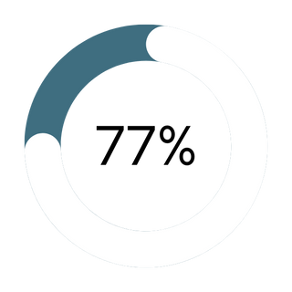
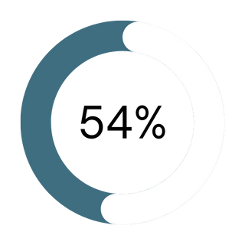
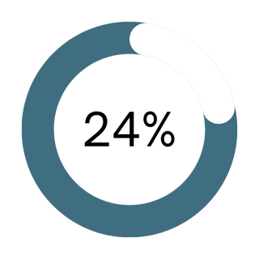
Key Performance Indicators
KPI # 1
KPI # 2
KPI # 3
Briefly elaborate on the KPI.
Briefly elaborate on the KPI.
Briefly elaborate on the KPI.

Slide 17

Got questions? Reach out.
Email
Social Media
Call us
hello@reallygreatsite.com
@reallygreatsite
123-456-7890

Slide 18


Resource
Page
Use these design resources in your Canva Presentation. Happy designing!
Delete or hide this page before presenting.

Slide 19
Resource Page
B for blur | C for confetti
D for a drumroll | M for mic drop
O for bubbles | Q for quiet
U for unveil | Any number from 0-9 for a timer
Find the magic and fun in presenting with Canva Presentations. Press the following keys while on Present mode!
Delete or hide this page before presenting.

Slide 20
Resource Page
Click the Share button on the top right corner of your screen and select 'Present and Record.'
Click ‘Go to recording studio,’ where you can choose the video and audio source for your video presentation.
Feel free to choose the ‘No camera’ option and record your voice only.
Start recording, and press pause in between takes if you have to.
Once you're done, download your Canva Presentation in MP4 file format or get a link to your Talking Presentation and share it with others.
You can also record a video inside the editor! Go to 'Uploads' and click on 'Record yourself'.
Presenting live not your thing? No worries! Record your Canva Presentation your audience can watch at their own pace.
Don't forget to delete or hide this page before presenting.

